Slide 1
Software Pricing:
Data Challenge
Gwen Spencer

Slide 2
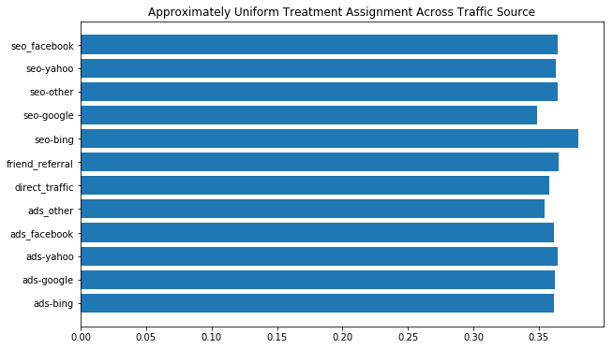

Check that study design was unbiased:

Slide 3
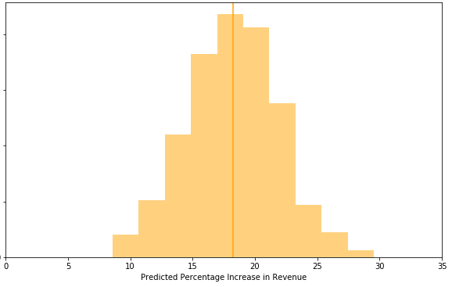
Recommendation: Increase Price to $59
Expected
Revenue
Increase:
18%

Slide 4
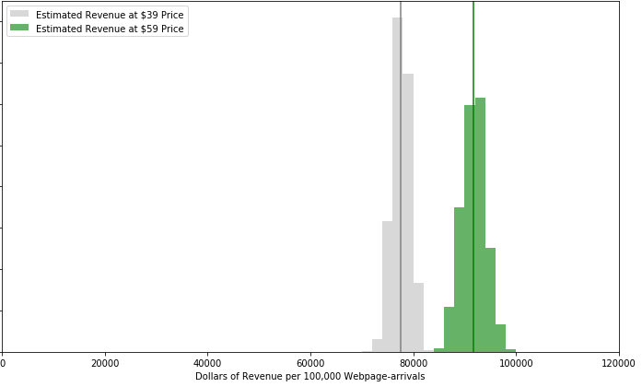
Recommendation: Increase Price to $59
Expected
Revenue
Increase:
18%

Slide 5
Recommendation: Increase Price to $59
Expected
Revenue
Increase:
18%
Savings in License
Support Costs?
Up to 22%
+

Slide 6
Recommendation: Increase Price to $59
Q: Other measures
to boost revenue?

Slide 7
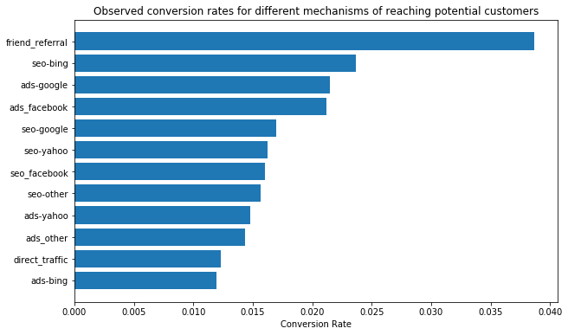
Conversion rate varies by traffic source
4%
Mechanism:
Endorsement?
Information?

Slide 8
Boost Friend Referrals?
Expected revenue per friend-referral click-through: $2.28
For now: incentivize successful referrals
“If your friend signs up at $49…
...you also get $10 back!”

Slide 9
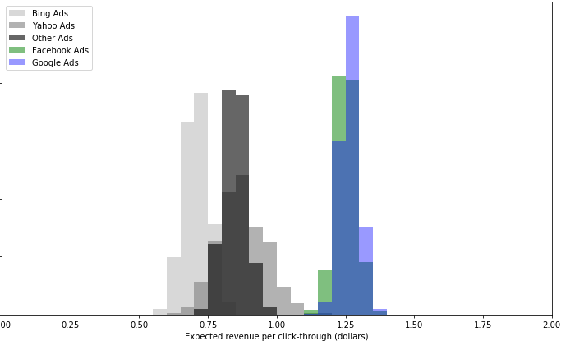
Ads: Revenue varies by Traffic Source

Slide 10
Revenue varies by Traffic Source:
Margin (Google) =
Revenue-per-click-through(Google) -
Cost-per-click-through(Google)
Shift budget towards Highest-Margin search engines

